Slide 1
Python
Sitanath Biswas

Slide 2
Python Operators
Python Operators
Operators are used to perform operations on variables and values.
Python divides the operators in the following groups:
Arithmetic operators
Assignment operators
Comparison operators
Logical operators
Identity operators
Membership operators
Bitwise operators

Slide 3
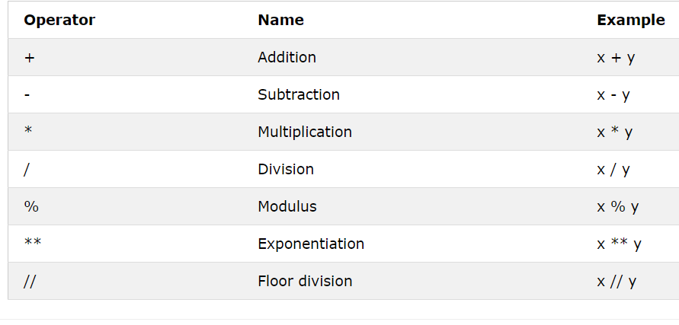
Python Operators
Python Arithmetic Operators
Arithmetic operators are used with numeric values to perform common mathematical operations:

Slide 4
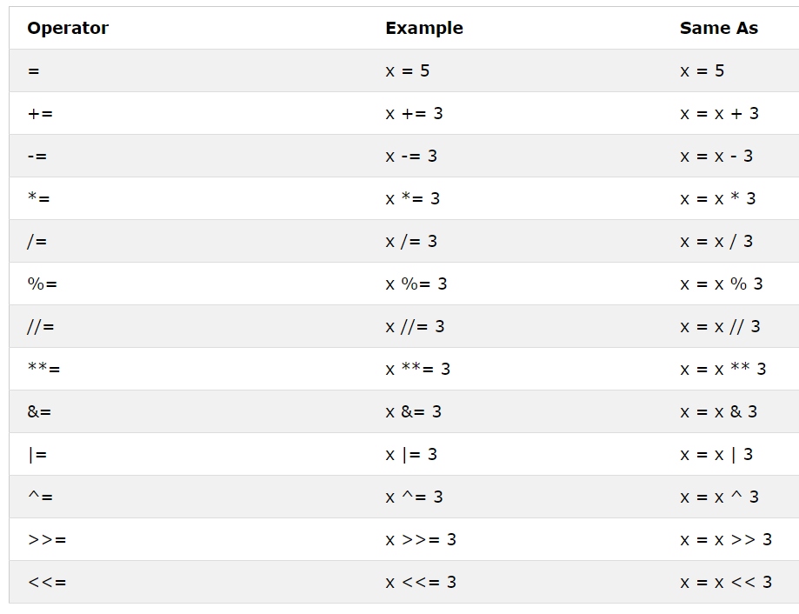
Python Operators
Python Assignment Operators
Assignment operators are used to assign values to variables:

Slide 5
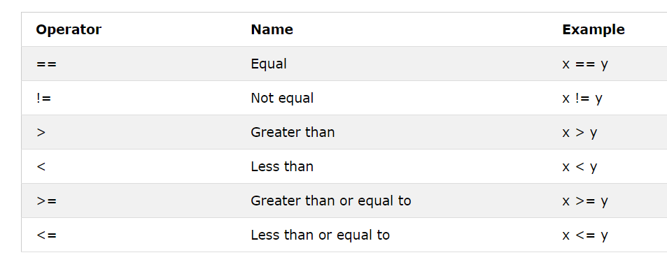
Python Operators
Python Comparison Operators
Comparison operators are used to compare two values:

Slide 6
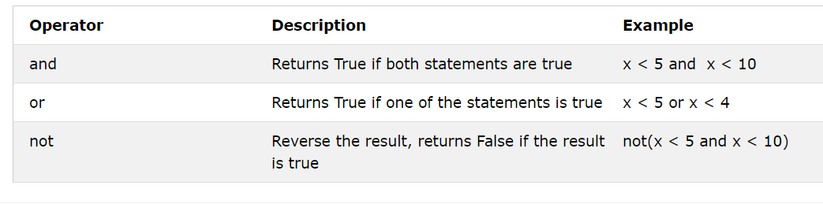
Python Operators
Python Logical Operators
Logical operators are used to combine conditional statements:

Slide 7
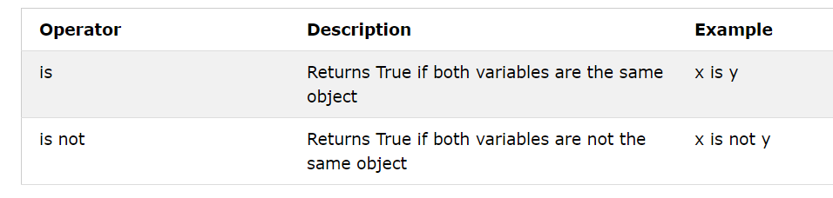
Python Operators
Python Identity Operators
Identity operators are used to compare the objects, not if they are equal, but if they are actually the same object, with the same memory location:

Slide 8
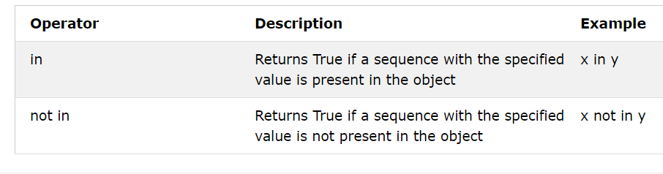
Python Operators
Python Membership Operators
Membership operators are used to test if a sequence is presented in an object:

Slide 9
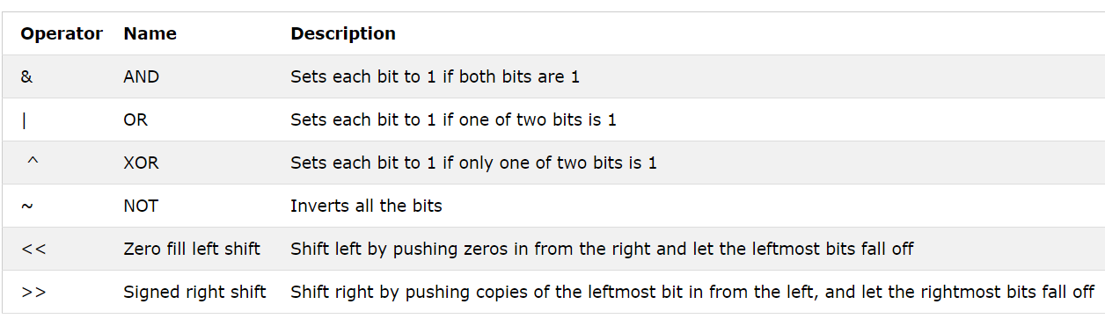
Python Operators
Python Bitwise Operators
Bitwise operators are used to compare (binary) numbers:

Slide 10
Python Lists
Python Collections (Arrays)
There are four collection data types in the Python programming language:
List is a collection which is ordered and changeable. Allows duplicate members.
Tuple is a collection which is ordered and unchangeable. Allows duplicate members.
Set is a collection which is unordered and unindexed. No duplicate members.
Dictionary is a collection which is unordered, changeable and indexed. No duplicate members.
When choosing a collection type, it is useful to understand the properties of that type. Choosing the right type for a particular data set could mean retention of meaning, and, it could mean an increase in efficiency or security.
List
A list is a collection which is ordered and changeable. In Python lists are written with square brackets.

Slide 11
Python Lists
Example
Create a List:
thislist = ["apple", "banana", "cherry"]
print(thislist)
Access Items
You access the list items by referring to the index number:
Example
Print the second item of the list:
thislist = ["apple", "banana", "cherry"]
print(thislist[1])

Slide 12
Python Lists
Negative Indexing
Negative indexing means beginning from the end, -1 refers to the last item, -2 refers to the second last item etc.
Example
Print the last item of the list:
thislist = ["apple", "banana", "cherry"]
print(thislist[-1])

Slide 13
Python Lists
Range of Indexes
You can specify a range of indexes by specifying where to start and where to end the range.
When specifying a range, the return value will be a new list with the specified items.
Example
Return the third, fourth, and fifth item:
thislist = ["apple", "banana", "cherry", "orange", "kiwi", "melon", "mango"]
print(thislist[2:5])

Slide 14
Python Lists
Note: The search will start at index 2 (included) and end at index 5 (not included).
Remember that the first item has index 0.
By leaving out the start value, the range will start at the first item:
Example
This example returns the items from the beginning to "orange":
thislist = ["apple", "banana", "cherry", "orange", "kiwi", "melon", "mango"]
print(thislist[:4])

Slide 15
Python Lists
By leaving out the end value, the range will go on to the end of the list:
Example
This example returns the items from "cherry" and to the end:
thislist = ["apple", "banana", "cherry", "orange", "kiwi", "melon", "mango"]
print(thislist[2:])

Slide 16
Python Lists
Range of Negative Indexes
Specify negative indexes if you want to start the search from the end of the list:
Example
This example returns the items from index -4 (included) to index -1 (excluded)
thislist = ["apple", "banana", "cherry", "orange", "kiwi", "melon", "mango"]
print(thislist[-4:-1])

Slide 17
Python Lists
Change Item Value
To change the value of a specific item, refer to the index number:
Example
Change the second item:
thislist = ["apple", "banana", "cherry"]
thislist[1] = "blackcurrant"
print(thislist)

Slide 18
Python Lists
Loop Through a List
You can loop through the list items by using a for loop:
Example
Print all items in the list, one by one:
thislist = ["apple", "banana", "cherry"]
for x in thislist:
print(x)

Slide 19
Python Lists
You will learn more about for loops in our Python For Loops Chapter.
Check if Item Exists
To determine if a specified item is present in a list use the in keyword:
Example
Check if "apple" is present in the list:
thislist = ["apple", "banana", "cherry"]
if "apple" in thislist:
print("Yes, 'apple' is in the fruits list")

Slide 20
Python Lists
List Length
To determine how many items a list has, use the len() function:
Example
Print the number of items in the list:
thislist = ["apple", "banana", "cherry"]
print(len(thislist))

Slide 21
Python Lists
Add Items
To add an item to the end of the list, use the append() method:
Example
Using the append() method to append an item:
thislist = ["apple", "banana", "cherry"]
thislist.append("orange")
print(thislist)

Slide 22
Python Lists
To add an item at the specified index, use the insert() method:
Example
Insert an item as the second position:
thislist = ["apple", "banana", "cherry"]
thislist.insert(1, "orange")
print(thislist)

Slide 23
Python Lists
Remove Item
There are several methods to remove items from a list:
Example
The remove() method removes the specified item:
thislist = ["apple", "banana", "cherry"]
thislist.remove("banana")
print(thislist)

Slide 24
Python Lists
The pop() method removes the specified index, (or the last item if index is not specified):
thislist = ["apple", "banana", "cherry"]
thislist.pop()
print(thislist)
The del keyword removes the specified index:
thislist = ["apple", "banana", "cherry"]
del thislist[0]
print(thislist)
The del keyword can also delete the list completely:
thislist = ["apple", "banana", "cherry"]
del thislist
The clear() method empties the list:
thislist = ["apple", "banana", "cherry"]
thislist.clear()
print(thislist)

Slide 25
Python Lists
Copy a List
You cannot copy a list simply by typing list2 = list1, because: list2 will only be a reference to list1, and changes made in list1 will automatically also be made in list2.
There are ways to make a copy, one way is to use the built-in List method copy().
Example
Make a copy of a list with the copy() method:
thislist = ["apple", "banana", "cherry"]
mylist = thislist.copy()
print(mylist)

Slide 26
Python Lists
Another way to make a copy is to use the built-in method list().
Example
Make a copy of a list with the list() method:
thislist = ["apple", "banana", "cherry"]
mylist = list(thislist)
print(mylist)

Slide 27
Python Lists
Join Two Lists
There are several ways to join, or concatenate, two or more lists in Python.
One of the easiest ways are by using the + operator.
Example
Join two list:
list1 = ["a", "b" , "c"]
list2 = [1, 2, 3]
list3 = list1 + list2
print(list3)

Slide 28
Python Lists
Another way to join two lists are by appending all the items from list2 into list1, one by one:
Example
Append list2 into list1:
list1 = ["a", "b" , "c"]
list2 = [1, 2, 3]
for x in list2:
list1.append(x)
print(list1)

Slide 29
Python Lists
Or you can use the extend() method, which purpose is to add elements from one list to another list:
Example
Use the extend() method to add list2 at the end of list1:
list1 = ["a", "b" , "c"]
list2 = [1, 2, 3]
list1.extend(list2)
print(list1)

Slide 30
Python Lists
The list() Constructor
It is also possible to use the list() constructor to make a new list.
Example
Using the list() constructor to make a List:
thislist = list(("apple", "banana", "cherry")) # note the double round-brackets
print(thislist)

Slide 31
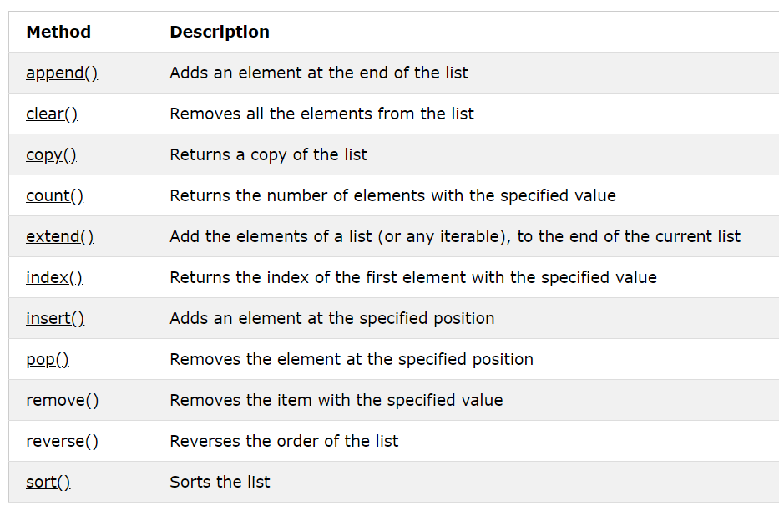
Python Lists
List Methods
Python has a set of built-in methods that you can use on lists.

Slide 32
Python Tuples
Tuple
A tuple is a collection which is ordered and unchangeable. In Python tuples are written with round brackets.
Example
Create a Tuple:
thistuple = ("apple", "banana", "cherry")
print(thistuple)

Slide 33
Python Tuples
Access Tuple Items
You can access tuple items by referring to the index number, inside square brackets:
Example
Print the second item in the tuple:
thistuple = ("apple", "banana", "cherry")
print(thistuple[1])

Slide 34
Python Tuples
Negative Indexing
Negative indexing means beginning from the end, -1 refers to the last item, -2 refers to the second last item etc.
Example
Print the last item of the tuple:
thistuple = ("apple", "banana", "cherry")
print(thistuple[-1])

Slide 35
Python Tuples
Range of Indexes
You can specify a range of indexes by specifying where to start and where to end the range.
When specifying a range, the return value will be a new tuple with the specified items.
Example
Return the third, fourth, and fifth item:
thistuple = ("apple", "banana", "cherry", "orange", "kiwi", "melon", "mango")
print(thistuple[2:5])

Slide 36
Python Tuples
Note: The search will start at index 2 (included) and end at index 5 (not included).
Remember that the first item has index 0.
Range of Negative Indexes
Specify negative indexes if you want to start the search from the end of the tuple:
Example
This example returns the items from index -4 (included) to index -1 (excluded)
thistuple = ("apple", "banana", "cherry", "orange", "kiwi", "melon", "mango")
print(thistuple[-4:-1])

Slide 37
Python Tuples
Change Tuple Values
Once a tuple is created, you cannot change its values. Tuples are unchangeable, or immutable as it also is called.
But there is a workaround. You can convert the tuple into a list, change the list, and convert the list back into a tuple.
Example
Convert the tuple into a list to be able to change it:
x = ("apple", "banana", "cherry")
y = list(x)
y[1] = "kiwi"
x = tuple(y)
print(x)

Slide 38
Python Tuples
Loop Through a Tuple
You can loop through the tuple items by using a for loop.
Example
Iterate through the items and print the values:
thistuple = ("apple", "banana", "cherry")
for x in thistuple:
print(x)

Slide 39
Python Tuples
Check if Item Exists
To determine if a specified item is present in a tuple use the in keyword:
Example
Check if "apple" is present in the tuple:
thistuple = ("apple", "banana", "cherry")
if "apple" in thistuple:
print("Yes, 'apple' is in the fruits tuple")

Slide 40
Python Tuples
Tuple Length
To determine how many items a tuple has, use the len() method:
Example
Print the number of items in the tuple:
thistuple = ("apple", "banana", "cherry")
print(len(thistuple))

Slide 41
Python Tuples
Add Items
Once a tuple is created, you cannot add items to it. Tuples are unchangeable.
Example
You cannot add items to a tuple:
thistuple = ("apple", "banana", "cherry")
thistuple[3] = "orange" # This will raise an error
print(thistuple)

Slide 42
Python Tuples
Create Tuple With One Item
To create a tuple with only one item, you have to add a comma after the item, otherwise Python will not recognize it as a tuple.
Example
One item tuple, remember the commma:
thistuple = ("apple",)
print(type(thistuple))
#NOT a tuple
thistuple = ("apple")
print(type(thistuple))

Slide 43
Python Tuples
Remove Items
Note: You cannot remove items in a tuple.
Tuples are unchangeable, so you cannot remove items from it, but you can delete the tuple completely:
Example
The del keyword can delete the tuple completely:
thistuple = ("apple", "banana", "cherry")
del thistuple
print(thistuple) #this will raise an error because the tuple no longer exists

Slide 44
Python Tuples
Join Two Tuples
To join two or more tuples you can use the + operator:
Example
Join two tuples:
tuple1 = ("a", "b" , "c")
tuple2 = (1, 2, 3)
tuple3 = tuple1 + tuple2
print(tuple3)

Slide 45
Python Tuples
The tuple() Constructor
It is also possible to use the tuple() constructor to make a tuple.
Example
Using the tuple() method to make a tuple:
thistuple = tuple(("apple", "banana", "cherry")) # note the double round-brackets
print(thistuple)

Slide 46
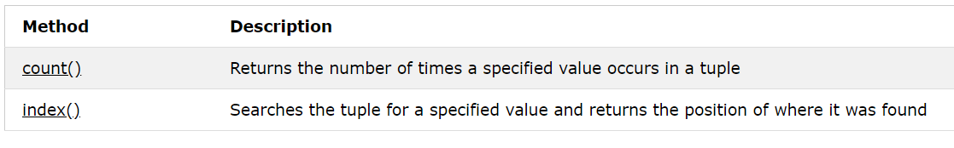
Python Tuples
Tuple Methods
Python has two built-in methods that you can use on tuples.

Slide 47
Python Tuples
thistuple = (1, 3, 7, 8, 7, 5, 4, 6, 8, 5)
x = thistuple.count(5)
print(x)
thistuple = (1, 3, 7, 8, 7, 5, 4, 6, 8, 5) x = thistuple.index(8) print(x)

Slide 48
THANK YOU

